Slide 1
Travel agent
CAPSTONE PROJECT
Presented By: Shreya Das
Student name : Shreya Das
College Name & Department : Kalinga Institute of Industrial Technology and Computer Science Engineering

Slide 2
OUTLINE
Problem Statement
Technology used
Wow factor
End users
Result
Conclusion
Git-hub Link
Future scope
IBM Certifications

Slide 3
Problem Statement
Problem Statement:
A Travel Planner Agent is an AI-powered assistant that helps users plan trips efficiently and intelligently.
It uses real-time data to suggest destinations, build itineraries, and recommend transport and accommodation options.
By understanding user preferences, budgets, and constraints, it tailors personalized travel plans.
Solution:
Integrated with maps, weather updates, and local guides, it ensures a smooth travel experience.
The agent can also manage bookings, alert users to changes, and optimize schedules on the go.
This smart assistant transforms complex travel planning into a seamless, enjoyable process.

Slide 4
Technology used
IBM cloud lite services
Natural Language Processing (NLP)
Retrieval Augmented Generation (RAG)
IBM Llama model

Slide 5
IBM cloud services used
IBM Cloud Watsonx AI Studio
IBM Cloud Watsonx AI runtime
IBM Cloud Agent Lab
IBM Llama foundation model

Slide 6
Wow factors
Personalized Itineraries based on user interests, budget, and preferences.
Live Context Awareness: Weather updates and destination info.
Interactive Maps and local attraction suggestions.
Multi-language Support using IBM Llama.
Booking Simulation with confirmation flow.
Dynamic Budget Summary in chat.
Smart Travel Nudges and reminders.
Fully Deployed on IBM Cloud Lite (Prompt Lab + Web Chat).
No-Code Editable Prompts for quick customization.
User-Friendly Interface with example prompts and friendly tone.

Slide 7
End users
Individual travelers (solo or group)
Business professionals planning work trips
Travel agencies and tour operators
Students and academic travelers
Families planning vacations
Digital nomads and remote workers
Event organizers (conferences, weddings, etc.)
Corporate travel departments

Slide 8
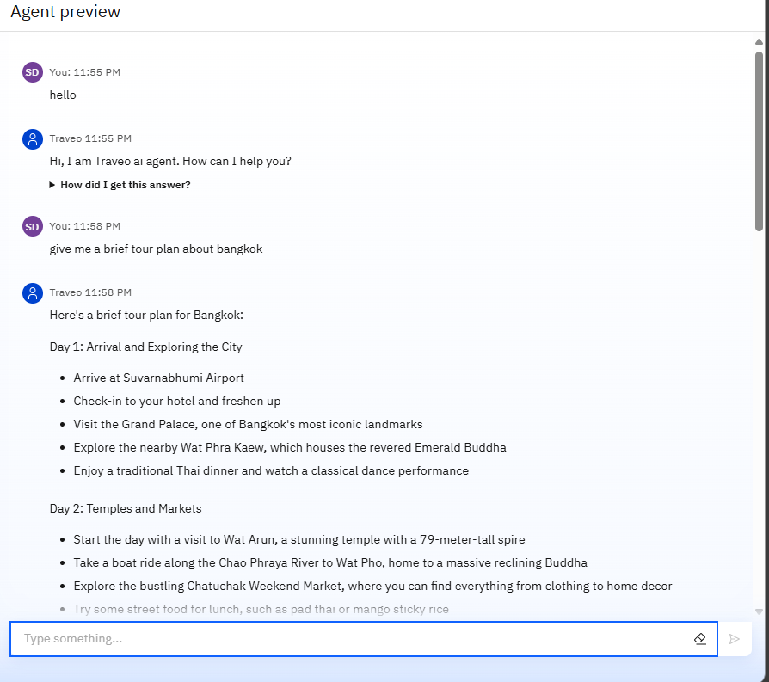
Results

Slide 9
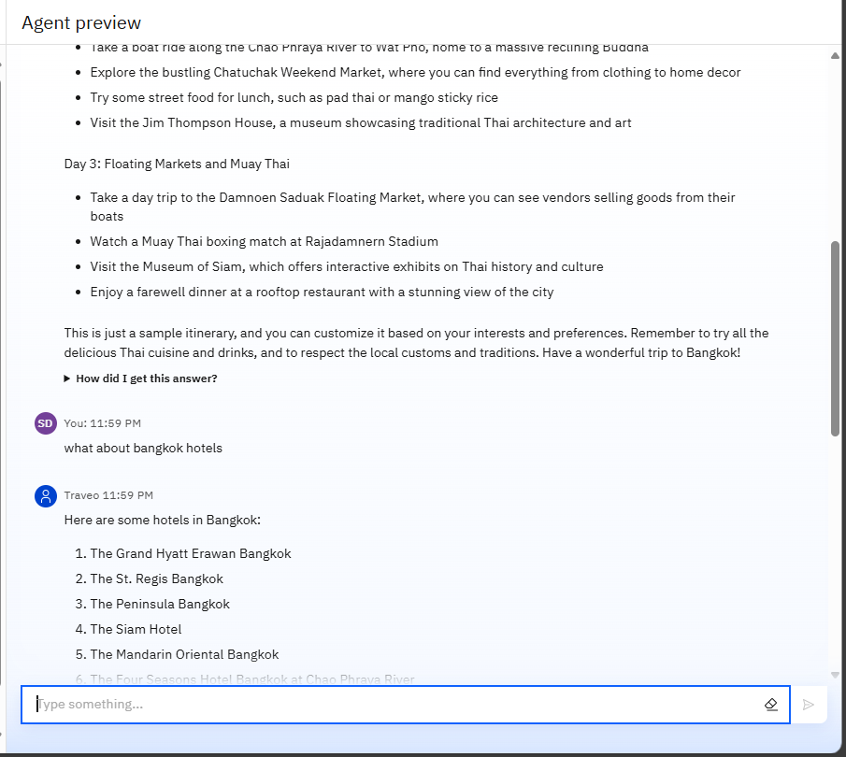
Results

Slide 10
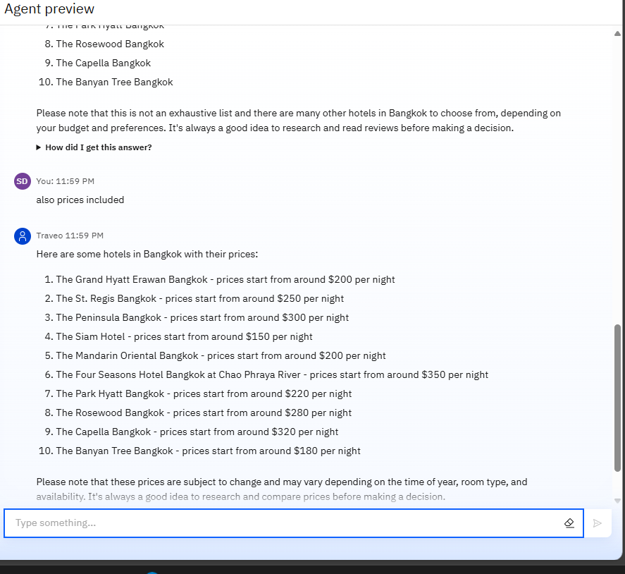
Results

Slide 11
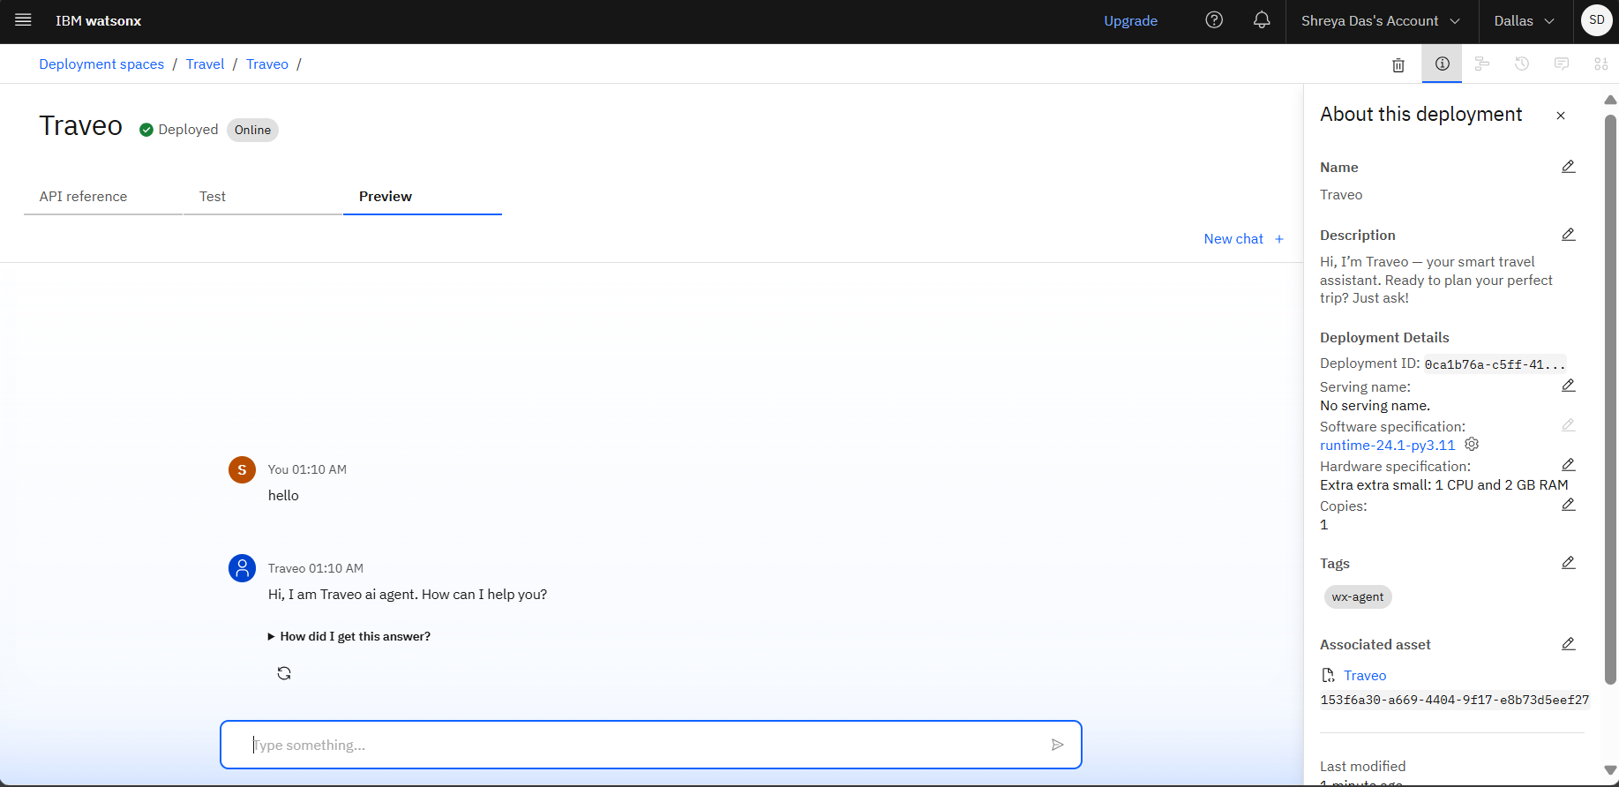
Results
Deployed AI Agent

Slide 12
Conclusion
Simplifies and automates complex travel planning tasks
Provides personalized, budget-friendly itineraries
Uses real-time data for accurate suggestions and updates
Enhances user experience through intelligent interaction
Adapts dynamically to changes like delays or cancellations
Saves time and reduces the stress of manual planning
Offers an all-in-one solution for modern travelers

Slide 13
Future scope
Integration with live booking platforms for instant flight, hotel, and activity reservations
Use of AI voice assistants for hands-free travel planning and updates
Support for multi-language conversations to serve global users
Incorporation of AR/VR previews of destinations and accommodations
Real-time currency exchange tracking and expense management
Personalized local experience suggestions using user behavior and reviews
Offline functionality for planning and access in low-connectivity areas
Deeper integration with public transport APIs for route optimization
Use of blockchain for secure bookings and identity verification
Expansion into corporate travel management and analytics tools

Slide 14
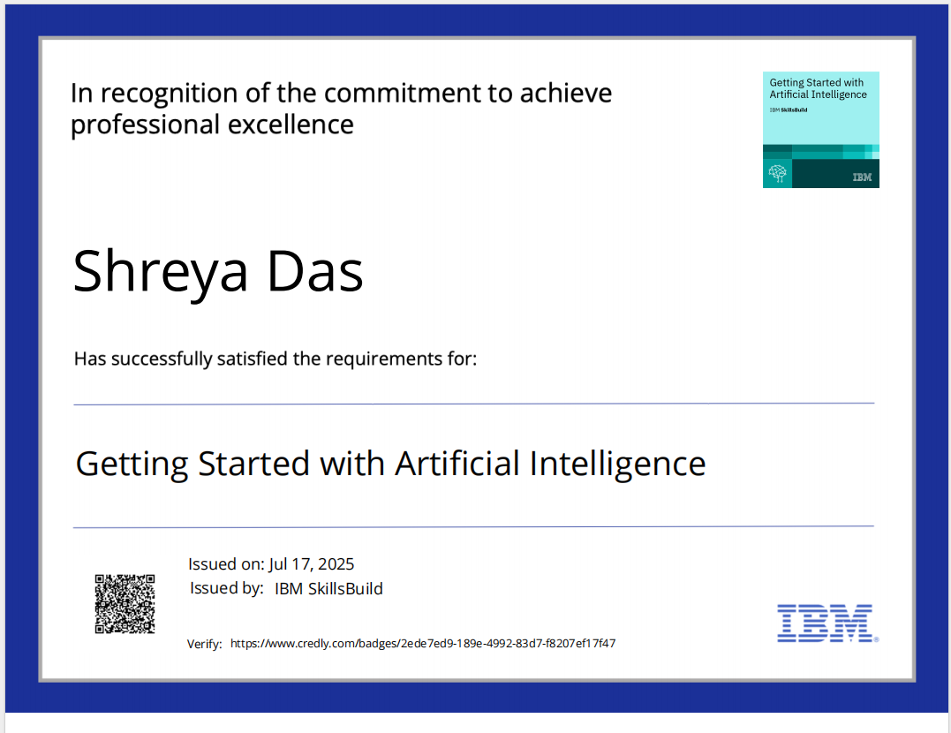
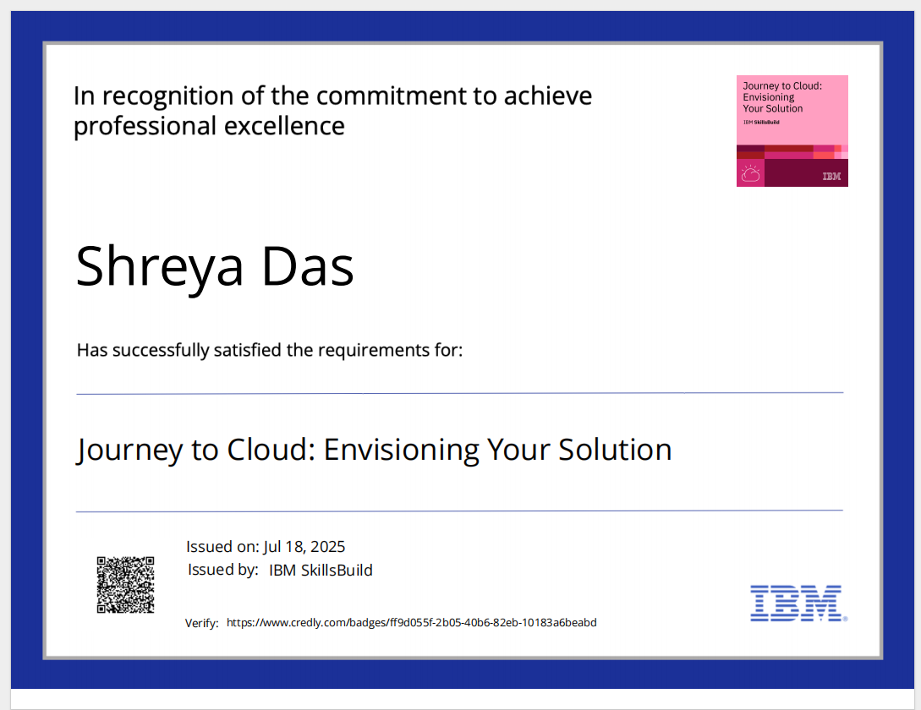
IBM Certifications

Slide 15
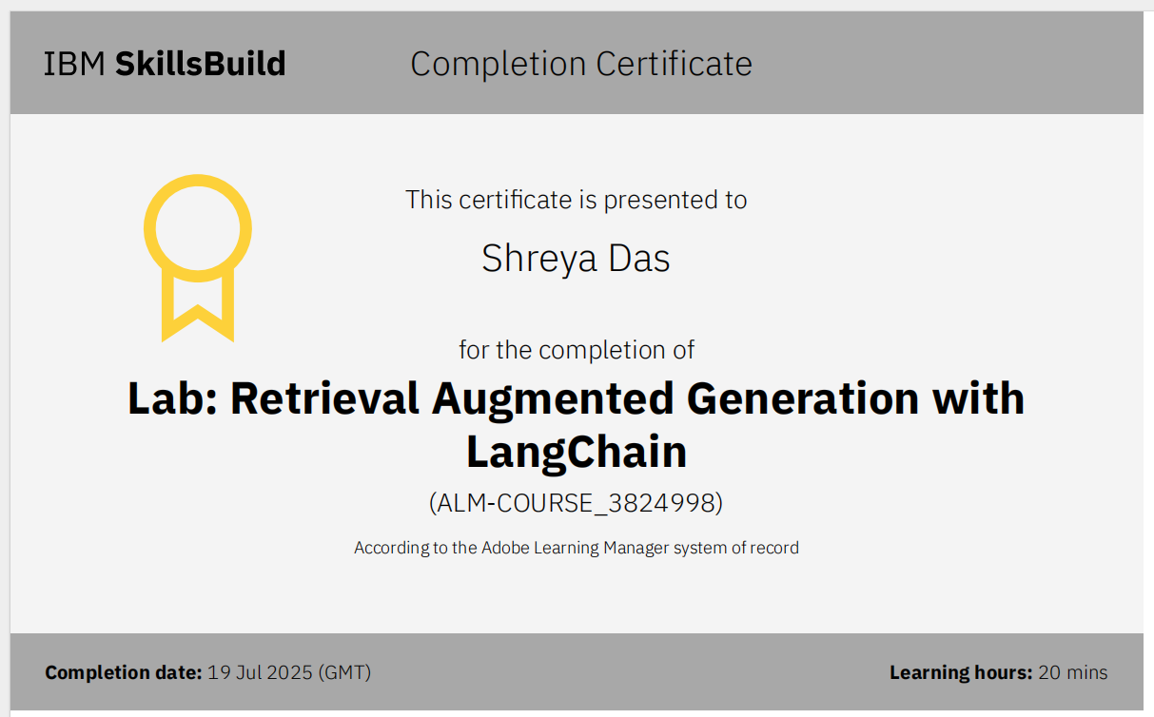

Slide 16
Git hub lik : https://github.com/sd8161/Traveo_Agent_ai

Slide 17
THANK YOU

